Slide 1

Krishi Hal
A Platform to empower rural India
TEAM NAME : Bright Tech

Slide 2
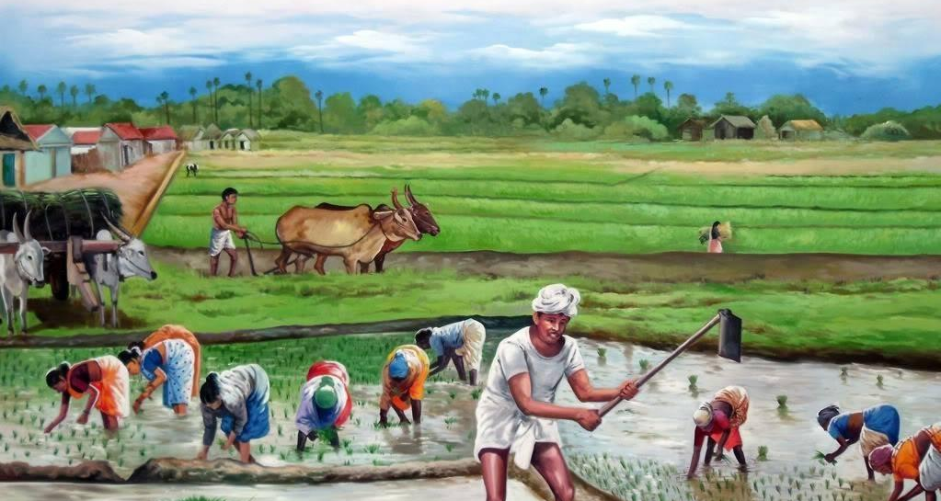
INTRODUCTION
Krishi HAL , here “hal” means “plough” which is the main tool for the farmers(kisan).
Similarly, “hal” also means “solution to a problem”.
Hence, this application acts as a relief to the helpless farmers.

Slide 3
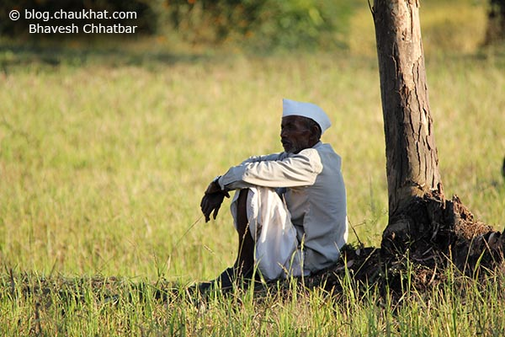
Why An App For Farmer?
Lack Of Info. to Farmers
Increased Suicidal Rate In Farmers
No Proper Platform For Farmers
Inadequate Facilities For Farmers

Slide 4
SUICIDE RATE
EXPECTED GROWTH RATE

Slide 5
POST HARVEST LOSS

Slide 6
STATS OF CROP LOSS DUE TO STORAGE.

Slide 7
FACILITIES:
Multi Lingual
Farmer Friendly
Weather Forecasting Acc. To User’s location
Learning Through Videos
Voice to text
Kisan Call Centre
Multi-purpose platform
Multi platform support
24*7 hotline service

Slide 8
What Makes Our App Unique ?
Our app acts as an interface b/w the farmer and the government websites as well as private firms.
The app provides certain services that are redirected to the respective govt. websites.
Hence, it helps the farmer to know the various facility being provided to them by the govt. , and also helps in accessing the govt. sites that are not known to the people.

Slide 9
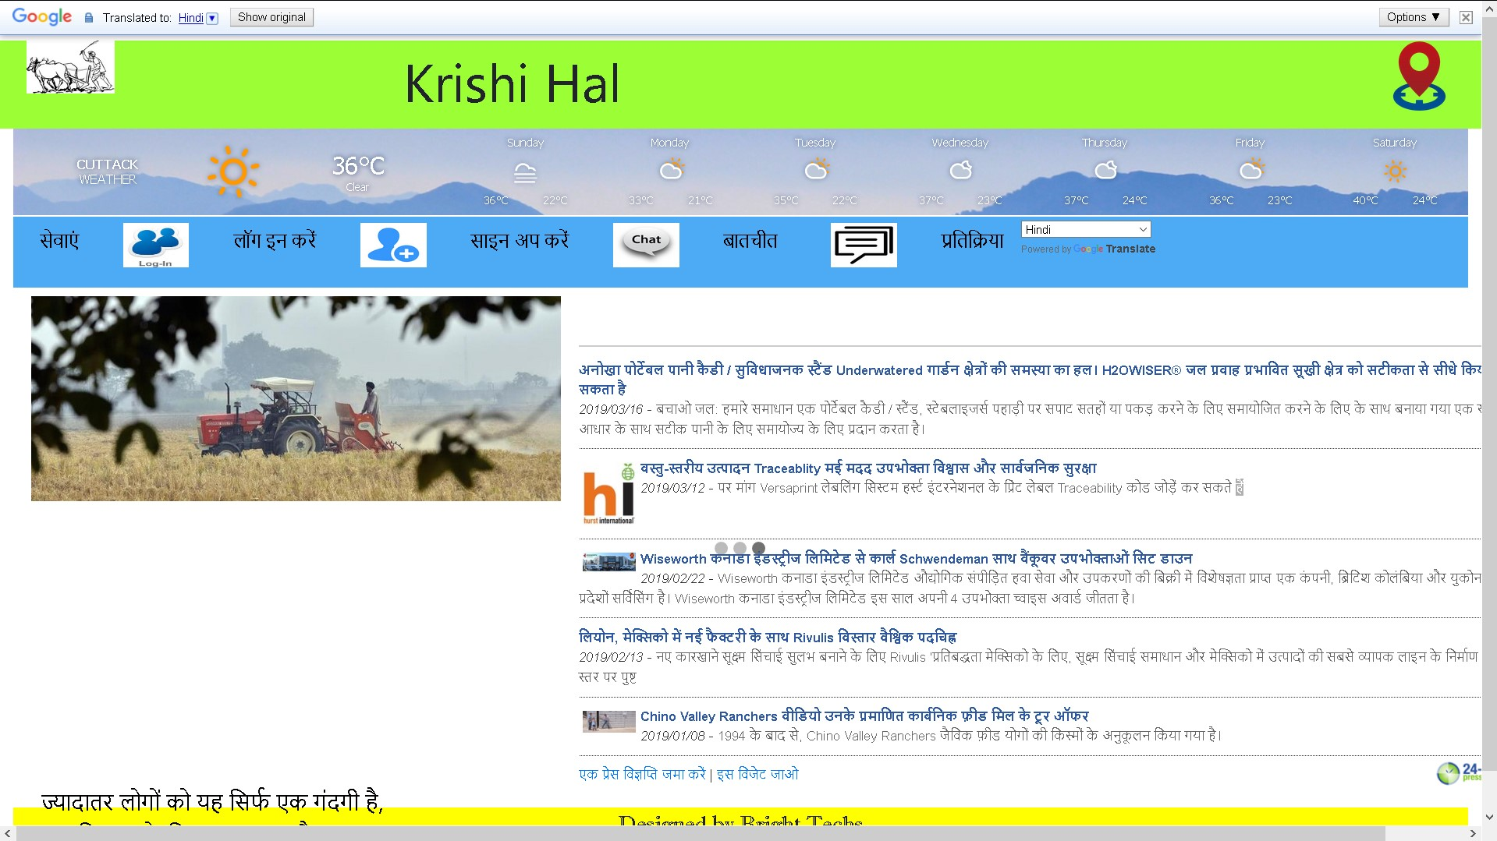
The view

Slide 10
Revenue Model
Our company
Funding by
Govt.
App download
Payments by google
Revenue collected
By collabs
Revenue collected by adds.

Slide 11
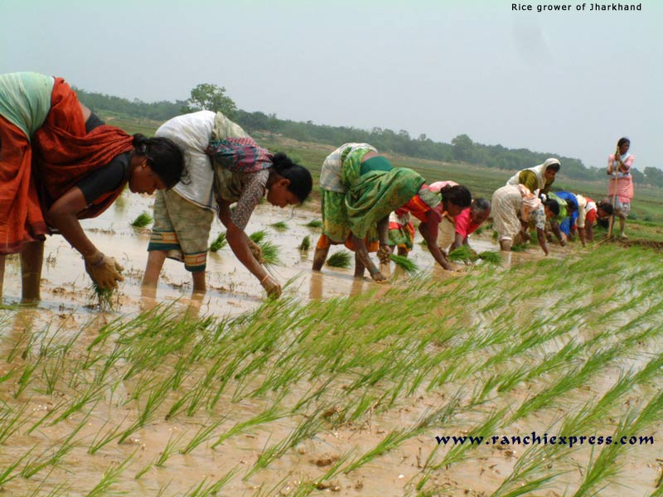
100% INVOLVEMENT OF FARMER
Since, there are only 30% of the farmers who use smart phones and rest are not familiar with it .
For the 30 % amart phone users we have our android app rest can use the mobile app.
Hence, there will be a set up in every village where there will be a organiser who will introduce this app to the rest of the farmers.
So, there will be a total participation of the farmers.

Slide 12


PLUGINS:
Google Translation API
Weather Forecasting API
Geolocation API
Firebase Database

Slide 13
THANK YOU

